Slide 1
Core Java project
By Dharshiniaathi

Slide 2
contents
Introduction
Main Class
Deposit
Withdraw
Check Balance
Output
Conclusion

Slide 3
Introduction
Build a java program, to create represent ATM Transaction, where a user has to choose input from the option displayed on the screen.
The available options are
Deposit
Withdraw
Check Balance
Exit

Slide 4
Main class
In this ATM Interface, is used to retrieve the information about the balance, deposit the money and withdraw also.
USER PIN NO: Already user pin no is set in this program, whenever user enter the pin no, program will check the entered pin no is correct or not. If the user enter the same set pin no, login operation will start. Otherwise, it sent error message “please Enter the valid Pin No”.
Next, It will show the options like Deposit, Withdraw and Check Balance.

Slide 5
USER CAN PERFORM
The option will be done using the switch statements.
TO DEPOSIT:
Take the amount user desires to deposit as input.
Add the received input from the user to balance and update its value.
amount=amount + deposit Amount;
Print a message on screen statin deposit transaction has been successfully.

Slide 6
TO WITHDRAW:
Take the amount user desires to withdraw as input.
If the balance amount greater than or equal to the withdraw amount then perform the transaction and give the user the desired amount.
amount=amount-withdraw Amount;
Else print Insufficient Balance Message.
System.out.println("Insufficient Balance.....! can't withdraw");

Slide 7
TO CHECK BALANCE:
Print a message on screen showing the value of balance amount.
System.out.println("Balance: "+amount);
EXIT:
Exit the current Transaction mode.
System.out.println("Exit....");
DEFAULT:
If the user enter the option not in the option list, it show the error message like “Invalid Option”.

Slide 8
While Loop:
In this program, while loop is used to loop the process till the user stop the transaction.
while(true) {
// here we write the switch statement
System.out.println("Do you want to continue (Y/N)");
char option=s.next().charAt(0);
if(option=='n’)
break;
}
Once, the user stop the process. Program will stop.

Slide 9
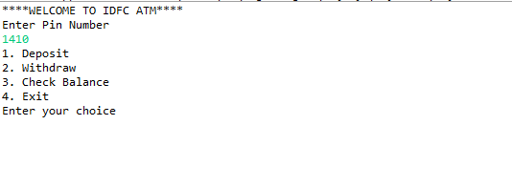
OUTPUT
Option for User

Slide 10
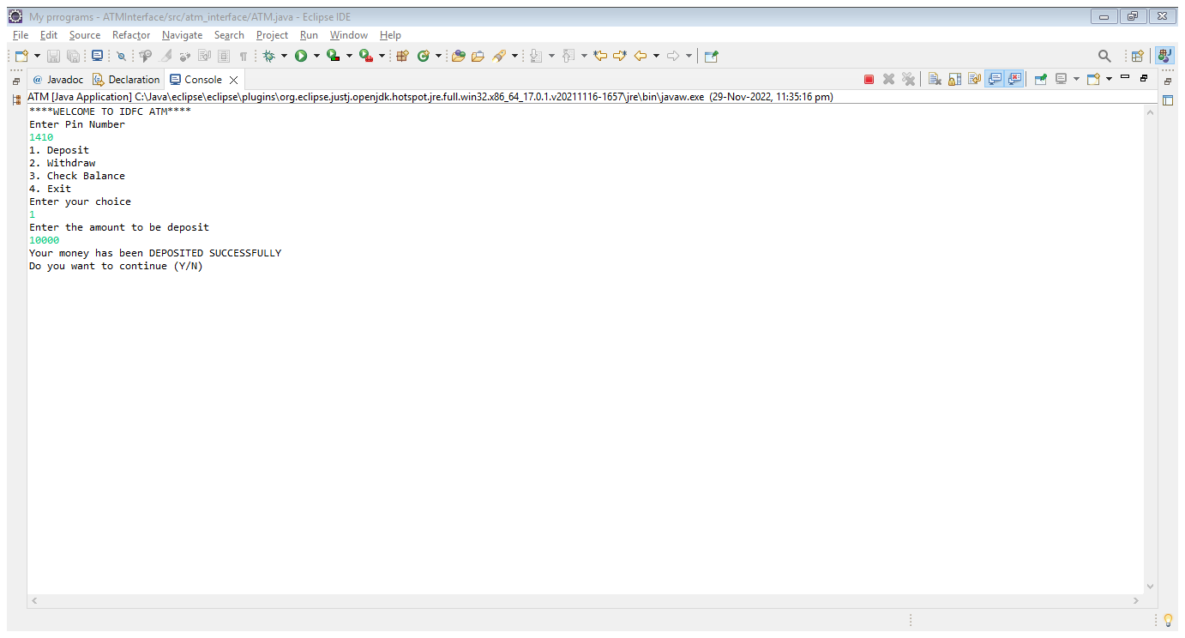
To Deposit Money

Slide 11
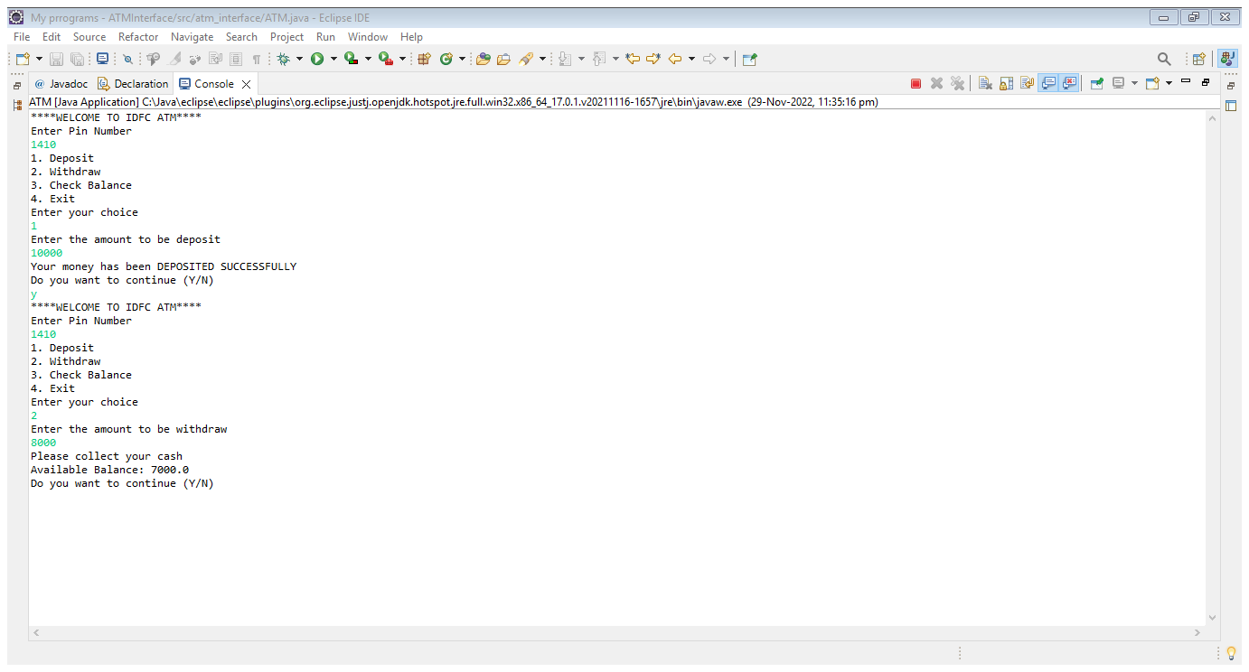
To Withdraw Money

Slide 12
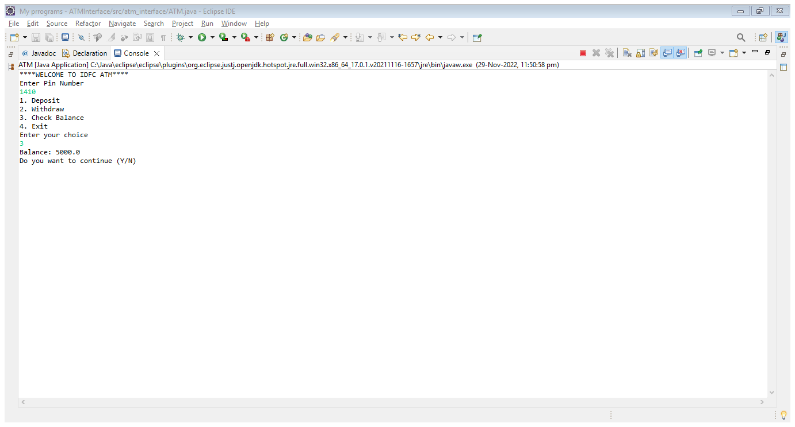
TO CHECK BALANCE

Slide 13
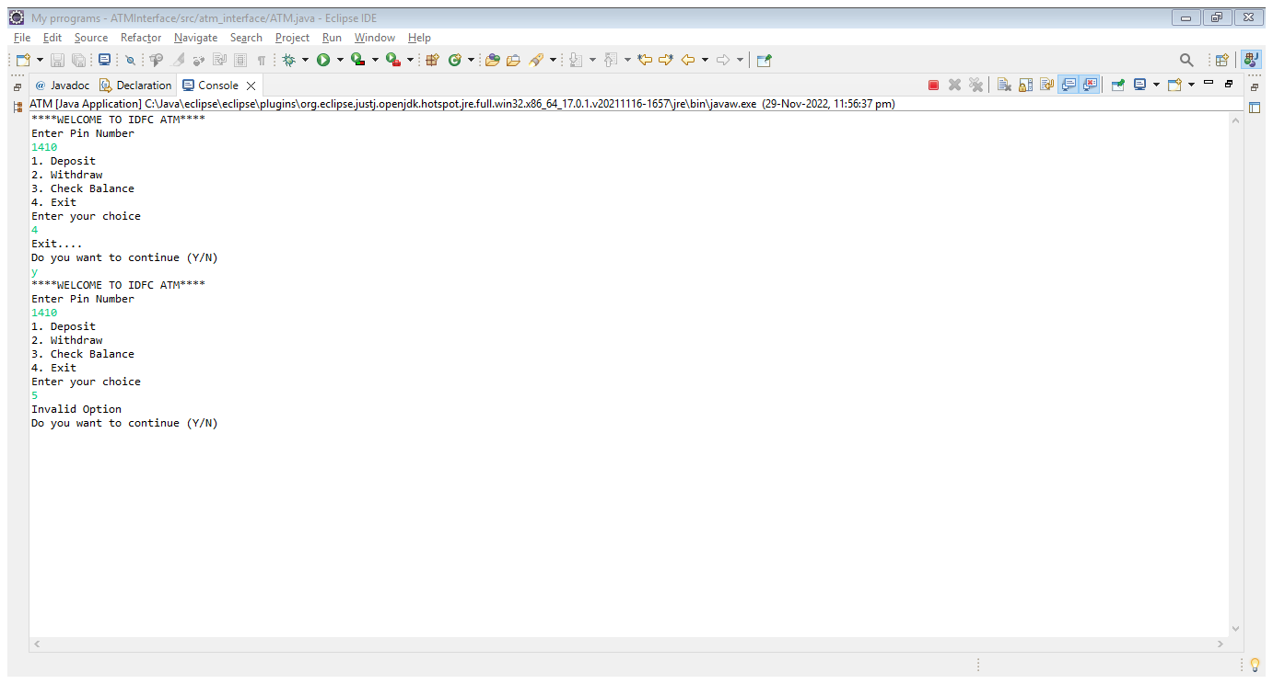
Exit and Default

Slide 14
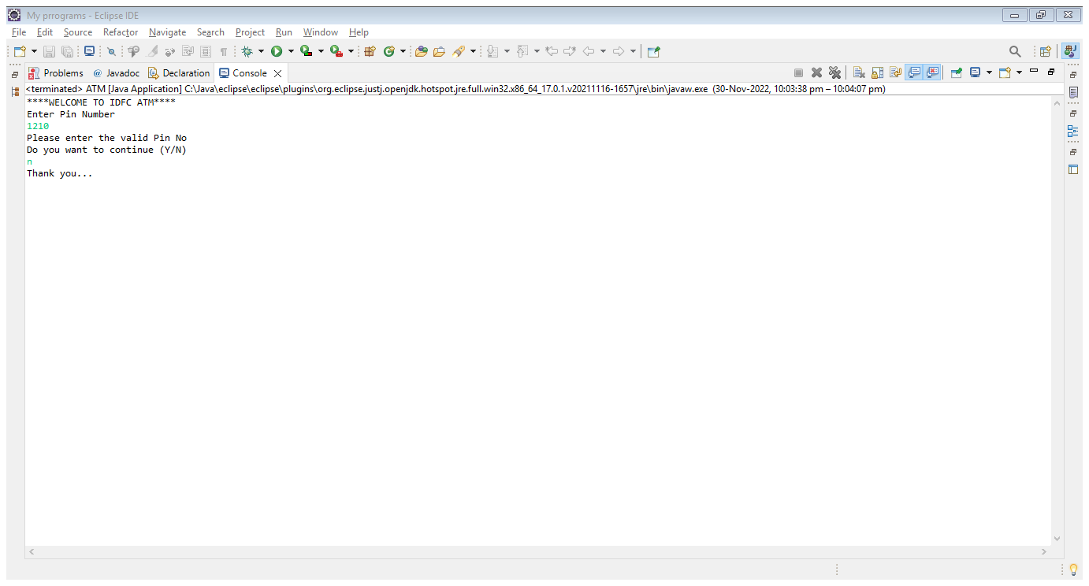
Exit from the whole process

Slide 15
Conclusion
Using the Java code, ATM Interface process is performed.
Finally, the ATM Interface is executed successfully without any interruptions

